Slide 1
Go Language Sharing
Bowen Chen
2016-11-21

Slide 2
Go History
Go originated as an experiment by Google engineers Robert Griesemer, Rob Pike, and Ken Thompson to design a new programming language that would resolve common criticisms of other languages while maintaining their positive characteristics. The new language was to:
be statically typed, scalable to large systems (as Java and C++).
be productive and readable, without too many mandatory keywords and repetition.
not require tooling, but support it well.
support networking and multiprocessing.
Go was announced in November 2009.
Go 1.0 was released in March 2012.
Go 1.5 was released in August 2015.
Go 1.7 was released in this year.

Slide 3
Go Basic
install(https://golang.org/doc/install)
workspaces(bin, pkg, src)
go tool(fmt build run get test…)
HelloWorld

Slide 4
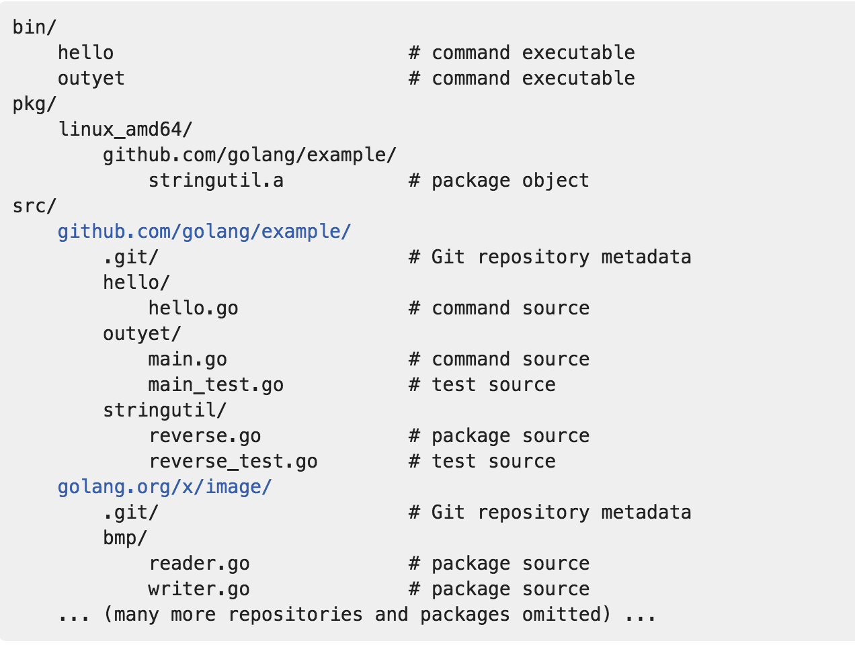

Slide 5
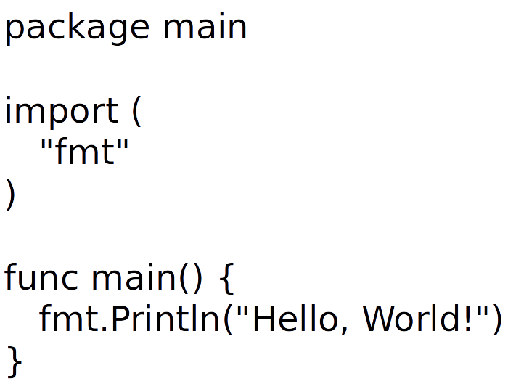

Slide 6
Go Variables And Types
Variables
A variable is a piece of storage containing a value.
var a int
a = 3
var a = 3
a := 3
Pointers
A pointer value is the address of a variable.
x := 1
p := &x
fmt.Println(*p) // "1"
*p = 2
fmt.Println(*p) // "2"

Slide 7
Types
basic data types
int8 int16 int32(rune) int64
uint8 uint16 unit32 unit64
float32 float64
complex64 complex128
var x complex128 = complex(1, 2)
bool
string
s := "hello, world"
fmt.Println(len(s))
fmt.Println(s[0], s[7]) // "104, 119" ('h' and 'w')
fmt.Println(s[0:5] // "hello"

Slide 8
Types
composite types
array
var a [3] int
fmt.Println(a[0])
slices
var x []int
x = append(x, 1)
x = append(x, 2, 3)
fmt.Println(x) // "[1, 2, 3]"
maps
var ages map[string]int
fmt.Println(ages == nil) // "true"
ages = make(map[string]int)
ages["bowen"] = 24

Slide 9
struct
type Point struct{ X, Y int }
p := Point{1, 2}
embedding and anonymous fields
type Circle struct {
Center Point
Radius int
}
type Circle struct {
Point
Radius int
}

Slide 10
Go Methods And Interfaces
Methods
Object is simply a value or variable that has methods,
and a method is a function associated with a particular type.
Interfaces
An interface is an abstract type, it reveals only some of their methods.
It specifies a set of methods that a concrete type must possess to be considered an instance of that interface.

Slide 11
declarations
package geometry
import "math"
type Point struct{ X, Y float64 }
// package-level function
func Distance(p, q Point) float64 {
return math.Hypot(q.X-p.X, q.Y-p.Y)
}
// method of type Point
func (p Point) Distance(q Point) float64 {
return math.Hypot(q.X-p.X, q.Y-p.Y)
}
p is called the method's receiver;
A common choice is the fisrt letter of the type name, like p for Point.

Slide 12
usage
p := Point{1, 2}
q := Point{4, 6}
fmt.Println(Distance(p, q)) // "5", function call
fmt.Println(p.Distance(q)) // "5", method call
With a pointer receiver
func (p *Point) ScaleBy(factor float64) {
p.X *= factor
p.Y *= factor
}

Slide 13
composition
declarations
import "image/color"
type ColoredPoint struct {
Point
Color color.RGBA
}
usage
red := color.RGBA{255, 0, 0, 255}
blue := color.RGBA{0, 0, 255, 255}
var p = ColoredPoint{Point{1, 1}, red}
var q = ColoredPoint{Point{5, 4}, blue}
fmt.Println(p.Distance(q.Point)) // "5"
p.ScaleBy(2)
q.ScaleBy(2)
fmt.Println(p.Distance(q.Point)) // "10"
encapsulation
type Point struct{ x, y float64 }

Slide 14
declarations
package io
type Writer interface {
Writer(p []byte) (n int, err error)
}
type Reader interface {
Read(p []byte) (n int, err error)
}
type Closer interface {
Close() error
}

